Slide 1
MH4518 Group 7 Presentation
By: Hrishi, Nicholas and Ziheng

Slide 2
Agenda
Product
Methodology
Sourcing our Data
Simulation Techniques
Models
Models and Results
Geometric BM
Heston (Stochastic Volatility)

Slide 3
Product
Our Product: Outperformance Bonus Certificate on EURO STOXX 50
Underlying Asset: EURO STOXX 50 Index (SX5E on Bloomberg)
Feature: Barrier Down-and-Out Call Option
Dates
Initial Fixing Date: 12 July 2022
Final Fixing Date: 14 July 2025
Prices
SX5E Initial Level: EUR 3,487.05
Barrier: EUR 1,743.525 (50% of initial level)
Initial Offering: EUR 1000

Slide 4
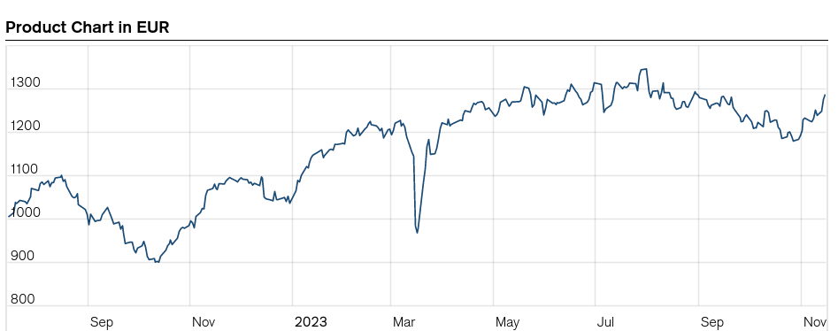
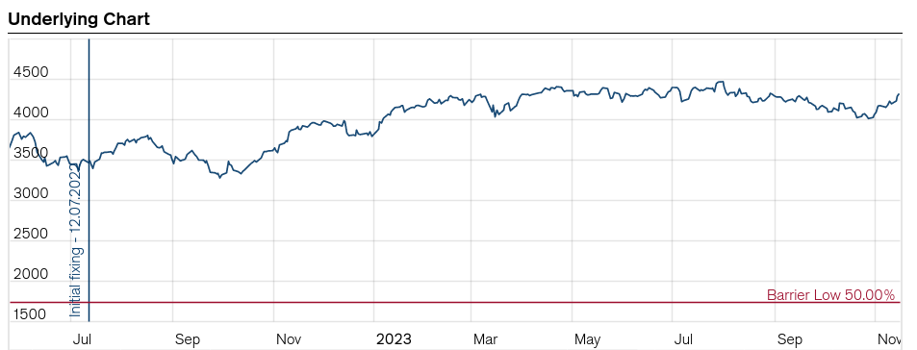

Slide 5
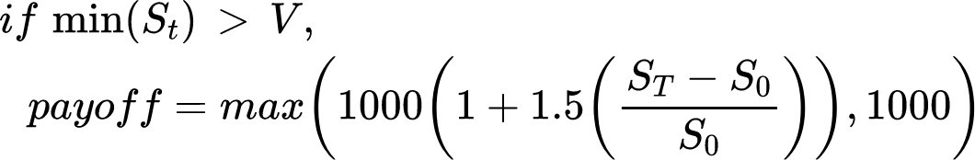
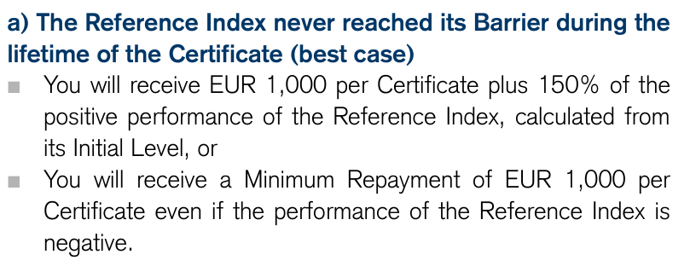
Product - Payoff
Payoff Scenarios:

Slide 6
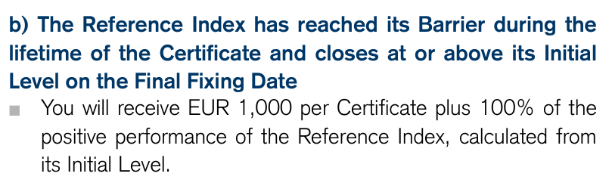
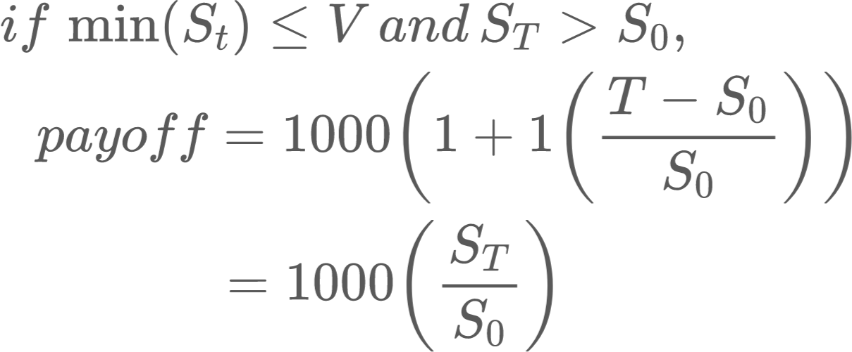
Product - Payoff
Payoff Scenarios:

Slide 7
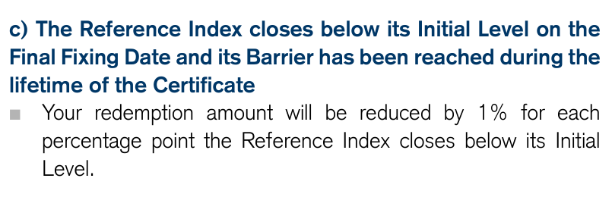
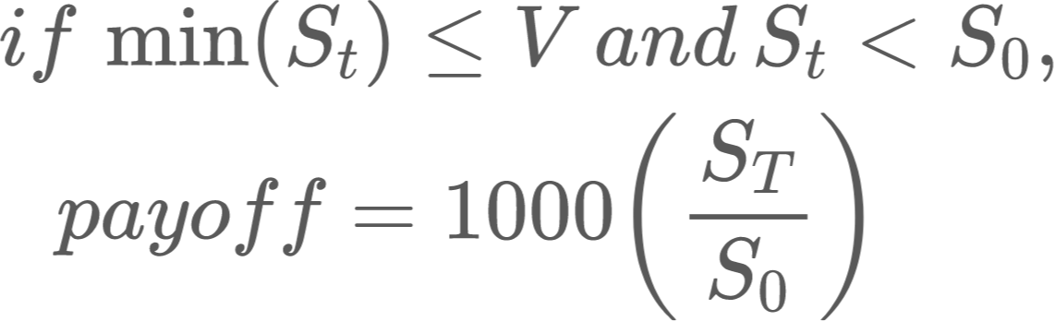
Product - Payoff
Payoff Scenarios:

Slide 8
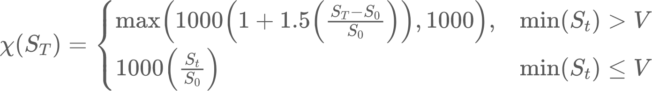
Product - Payoff
Payoff Scenarios:
Payoff Function:

Slide 9
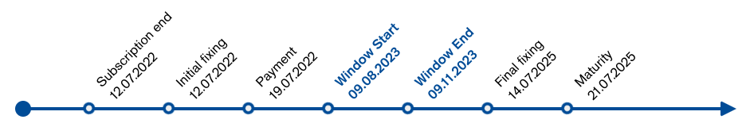
Product - Timeline

Slide 10
Methodology - Sourcing our Data
Data Sources
Stock Data S_{t}: ^STOXX50E from Yahoo Finance
Dates: 2 Aug 2022 - 13 Nov 2023 (daily)
Interest Rate r: Euro Area Yield Curves with 1Y Maturity from ECB
Dates: 6 Sep 2004 - 13 Nov 2023 (daily)
Actual Derivative Price: Web-scraped from Credit Suisse
Dates: 15 Jul 2022 - 10 Nov 2023 (daily)
Options Quote Prices for Underlying Asset: Taken from Bloomberg Terminal
Dates: 11 Aug 2023 - 15 Mar 2024 (option prices for 11 different expiration dates)

Slide 11
Methodology - Simulation Techniques
Techniques Used
Monte Carlo
Antithetic Variates
Control Variates
1-shoot Stratified Sampling (not applicable to path-dependent derivatives)
Empirical Martingale Correction

Slide 12
Models - Geometric Brownian Motion (GBM)
General Process
Obtain / calculate model parameters from historical data
Risk-free interest rate r (taken from ECB)
Initial asset price for each day in window S₀
Total simulation duration T
Volatility σ
Plug model parameters into our simulation functions (MC, AV, CV, SS, EMS) to simulate N price paths of the SX5E stock
Calculate payoff of each price path for N simulations
Estimate option price by “pulling back” from payoff and taking mean

Slide 13
Models - Geometric Brownian Motion (GBM)
Simulation Setup
Historical Data
For each day in sliding window (e.g. 9 Aug 2023),
r: Taken from previous day (e.g. 8 Aug 2023)
S₀: Taken from current day (e.g. 8 Aug 2023)
σ: Calculated from previous M timesteps (e.g. 252 working days)
T: Calculated from current day (e.g. 485 working days from final fixing date)

Slide 14
Models - Geometric Brownian Motion (GBM)
Simulation Setup
No. of Simulations N: 1,000,000
Sliding Window
Start Date: 9 Aug 2023
End Date: 9 Nov 2023
Total Working Days: 66
Lookback Periods
3 months (63 working days)
1 year (252 working days)

Slide 15
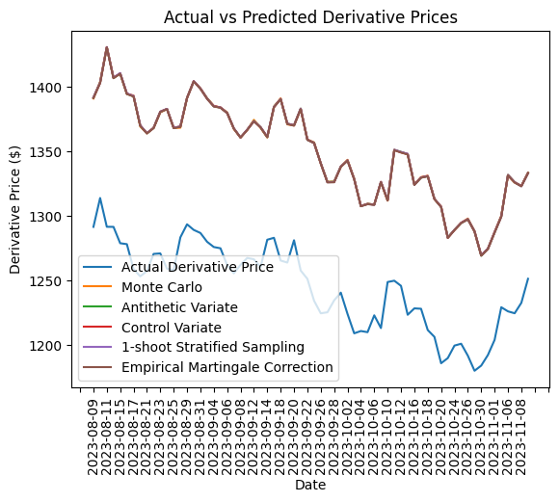
Models - Geometric Brownian Motion (GBM)
How much is the product worth today?

Slide 16
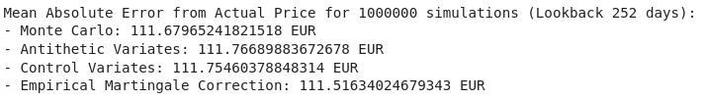
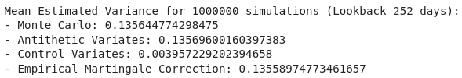

Models - Geometric Brownian Motion (GBM)

Slide 17



Models - Geometric Brownian Motion (GBM)

Slide 18
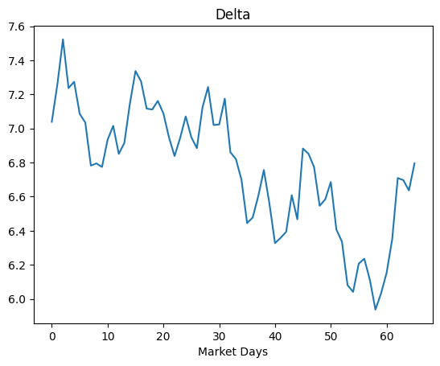
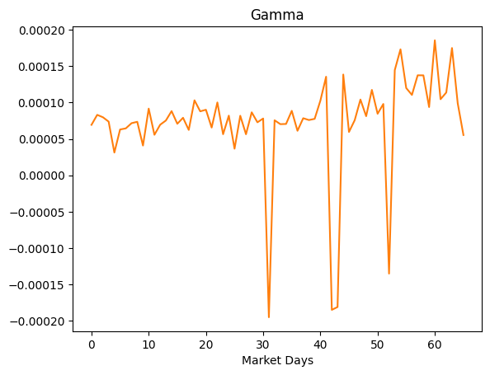
Sensitivities for Monte Carlo Simulation

Slide 19
Models - Geometric Brownian Motion (GBM)
Simulation Enhancement: Just-in-time compilation (Numba)
Rewrote simulation functions to comply with Numba’s
Adding a @jit in front of the simulation function compiles the Python code to machine code, which runs hundreds of times faster
Simulation Enhancement: Parallel processing (concurrent.futures)
Used multiple processes to parallelize different simulation days
Divides runtime by no. of CPUs available
Improvement:
Cut projected simulation time of 1 million simulations over 66 days using 5 simulation techniques from 30h to 1h

Slide 20
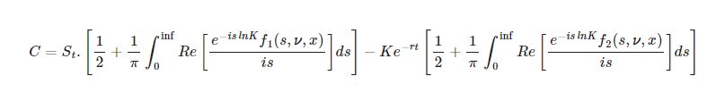
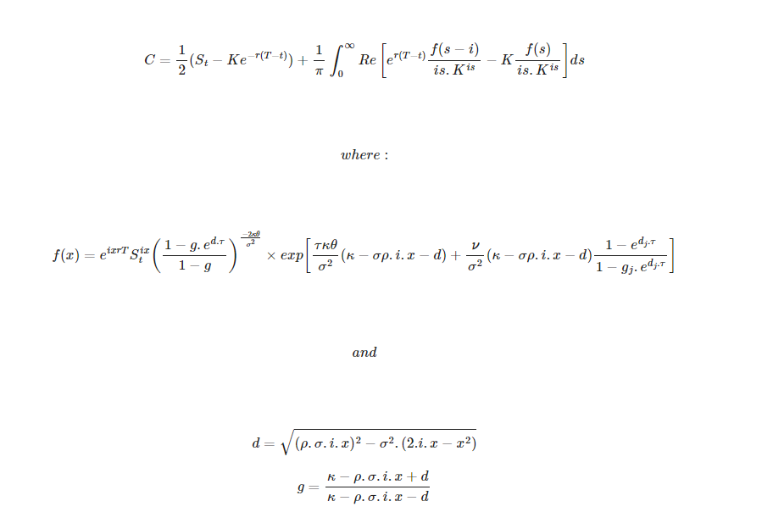
Models - Heston SV
Heston Pricing Formula:
Simplified (Single Integral) Formula for Heston Pricing:

Slide 21
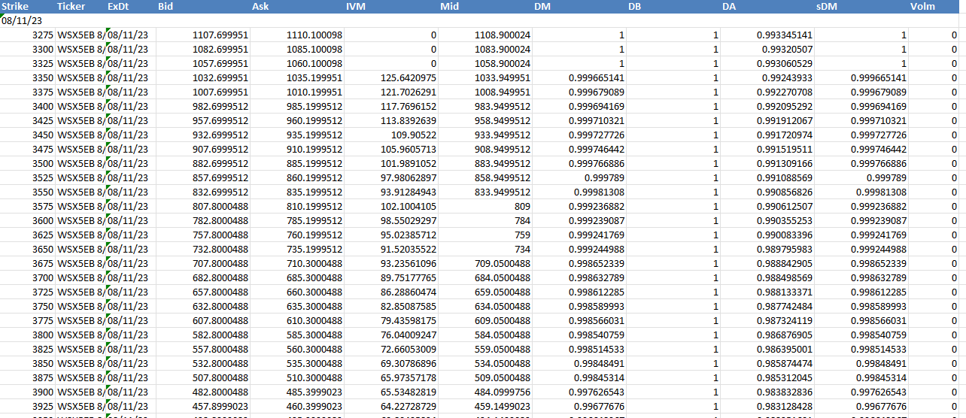
Models - Heston SV
Dataset:
Options Quote Prices for Underlying Asset: Taken from Bloomberg Terminal
Expiration Dates: 11 Aug 2023 - 15 Mar 2024 (11 different dates)
Dataset example:

Slide 22
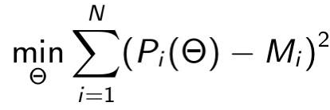
Models - Heston SV
Initializing parameters and defining objective function
Θ = (κ, θ, ξ, ρ, V₀)= (0.5, 0.5, 0.5, -0.5, 0.17)
r, S_{t}
Objective Function:
Upper and Lower Bounds: (3, 3, 5, 0, 1), (10⁻², 10⁻², 10⁻², -1, 10⁻²)
Optimization Function: Levenberg Marquardt algorithm
Calibration Results:
Θ = (κ, θ, ξ, ρ, V₀) = (9.82380774, 0.05478766, 0.02353233, -0.95117468, 2.83318275)

Slide 23
Models - Heston SV
Simulation Setup
No. of Simulations: 1,000,000
Simulation Dates
9 Aug 2023 :(
Θ = (κ, θ, ξ, ρ, V₀) = (9.82380774, 0.05478766, 0.02353233, -0.95117468, 2.83318275)
S_{t}, r

Slide 24
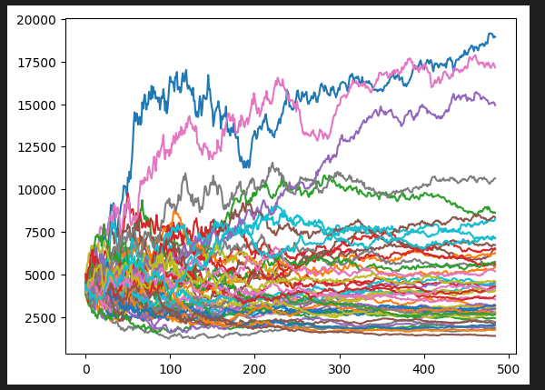
Example of Simulated Underlying Paths (Monte Carlo)

Slide 25
Models - Heston SV Results
After applying payoff function + discounting factor:
Predicted Value for 9 Aug 2023: 1504.36 EUR
Estimated Variance: 1.238661441
95% Confidence Interval:
[1502.18, 1506.54]
Absolute Error: 212.90

Slide 26
Thank You!
Q & A

